Slide 1
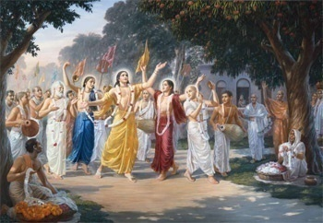
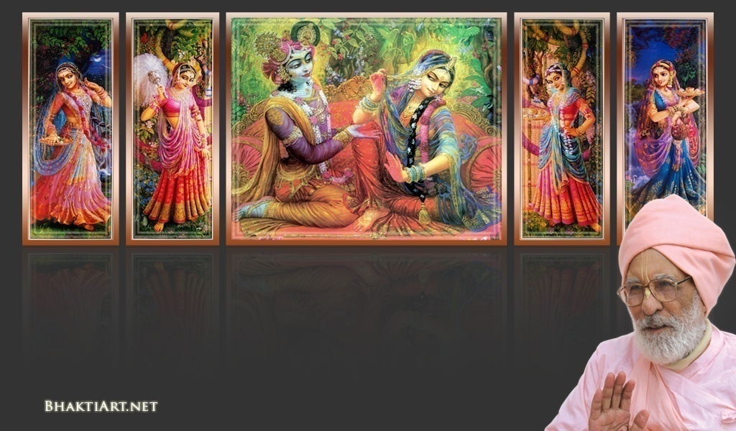
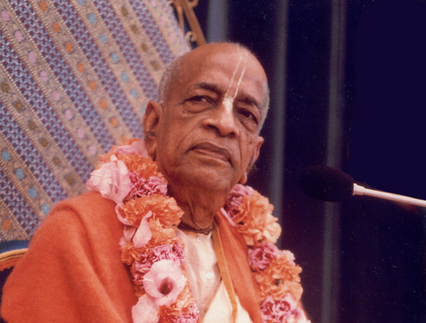
Sri Krsna Caitanya Prabhu Nityananda
Sri Advaita Gadadara Srivasadi
Gaura Bhakta Vrinda
Week 343
May 15 2015
Hare Krsna Hare Krsna
Krsna Krsna Hare Hare
Hare Rama Hare Rama
Rama Rama Hare Hare
Gokul Bhajan & Vedic Studies
North Carolina, USA
Notes:
Om Ajnana timirandhasya, jnananjana salakaya
Caksur unmimiltam yena, tasmai sri gurave namah
Namah om vishnu padaya, radhikayah priyatmane
Sri-srimad bhaktivedanta, narayana iti namine
Narayanam gurum vande
Saranam bhakta baandhavam
Gaura manobhishtam purnam
Radha daasyam pradaayakam
Rupaanugaacarya varyam
Rupa manjari preshtakam
Patita paavana baandhava
Yugaacarya naaraayanam
Sri krishna lila kathane sudaksham
Audarya-madhurya gunais ca yuktam
Varam varenyam purusham mahantam
Narayanam tvam sirasa namami
He krishna karuna sindho, dina bandho jagat pate
Gopesha gopika kanta, radha kanta namo ‘stu te
tapta kancana gaurangi, radhe vrindavaneshvari
vrsabhanu sute devi, pranamami hari priye
bhajami radham aravinda netram
smarami radham madhurasmi-tasyam
vadami radham karuna bharardram
tato mam anyasti gatir na kapi
--------------------------
First of all, I pay my koti dandavat pranams to my diksha guru Om vishnupada rupanuga acharya Sri Sri Bhakti Vedanta Narayana Goswami maharaja. My koti dandavat pranams to Sri Sri Bhakti Vedanta Swami Prabhupada, and guru varga.
My humble pranams at the lotus feet of all assembled devotees, vaishnavas and vaishnavis..

Slide 2
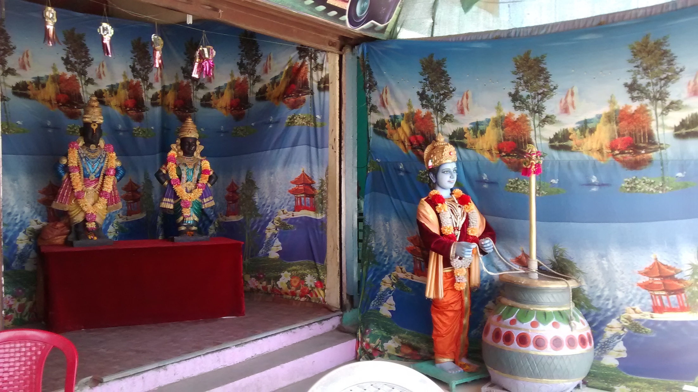
Pilgrimage Memories -6 Vitala Panduranga

Slide 3
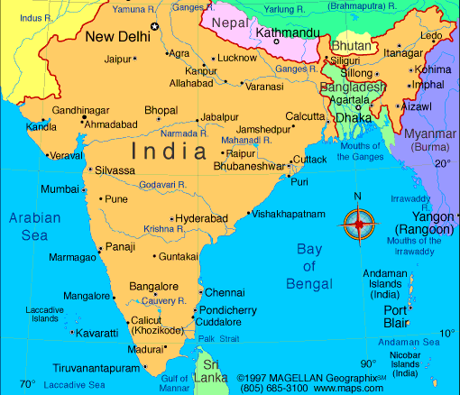
4 Weeks from Feb 23..
Chennai -> Kurdha Rd
Kurdha Rd to Puri
Puri to Calcutta
Calcutta to Nawadwip
Nawadwip to Calcutta
Calcutta to Delhi
Delhi > Aniruddh Prabhu
Aniruddh home to Jaipur
Jaipur to Mathura Vrindavan
Mathura to Pune, Kurdvadi
Kurdvadi to Pandarpur
Pandarpur to Kurdvadi
Kurdvadi to Manthralaya
Manthralaya to Sindhanur
Sindhanur to Kishkintha
Kishkintha to Sindhanur
Sindhanur to Bangalore
Bangalore to Chennai
Chennai to Kanyakumari
Notes:
....
Coromandal express.. Reservation was pending for months..
But on that day it got confirmed..
Muslims in the train at midnight..

Slide 4
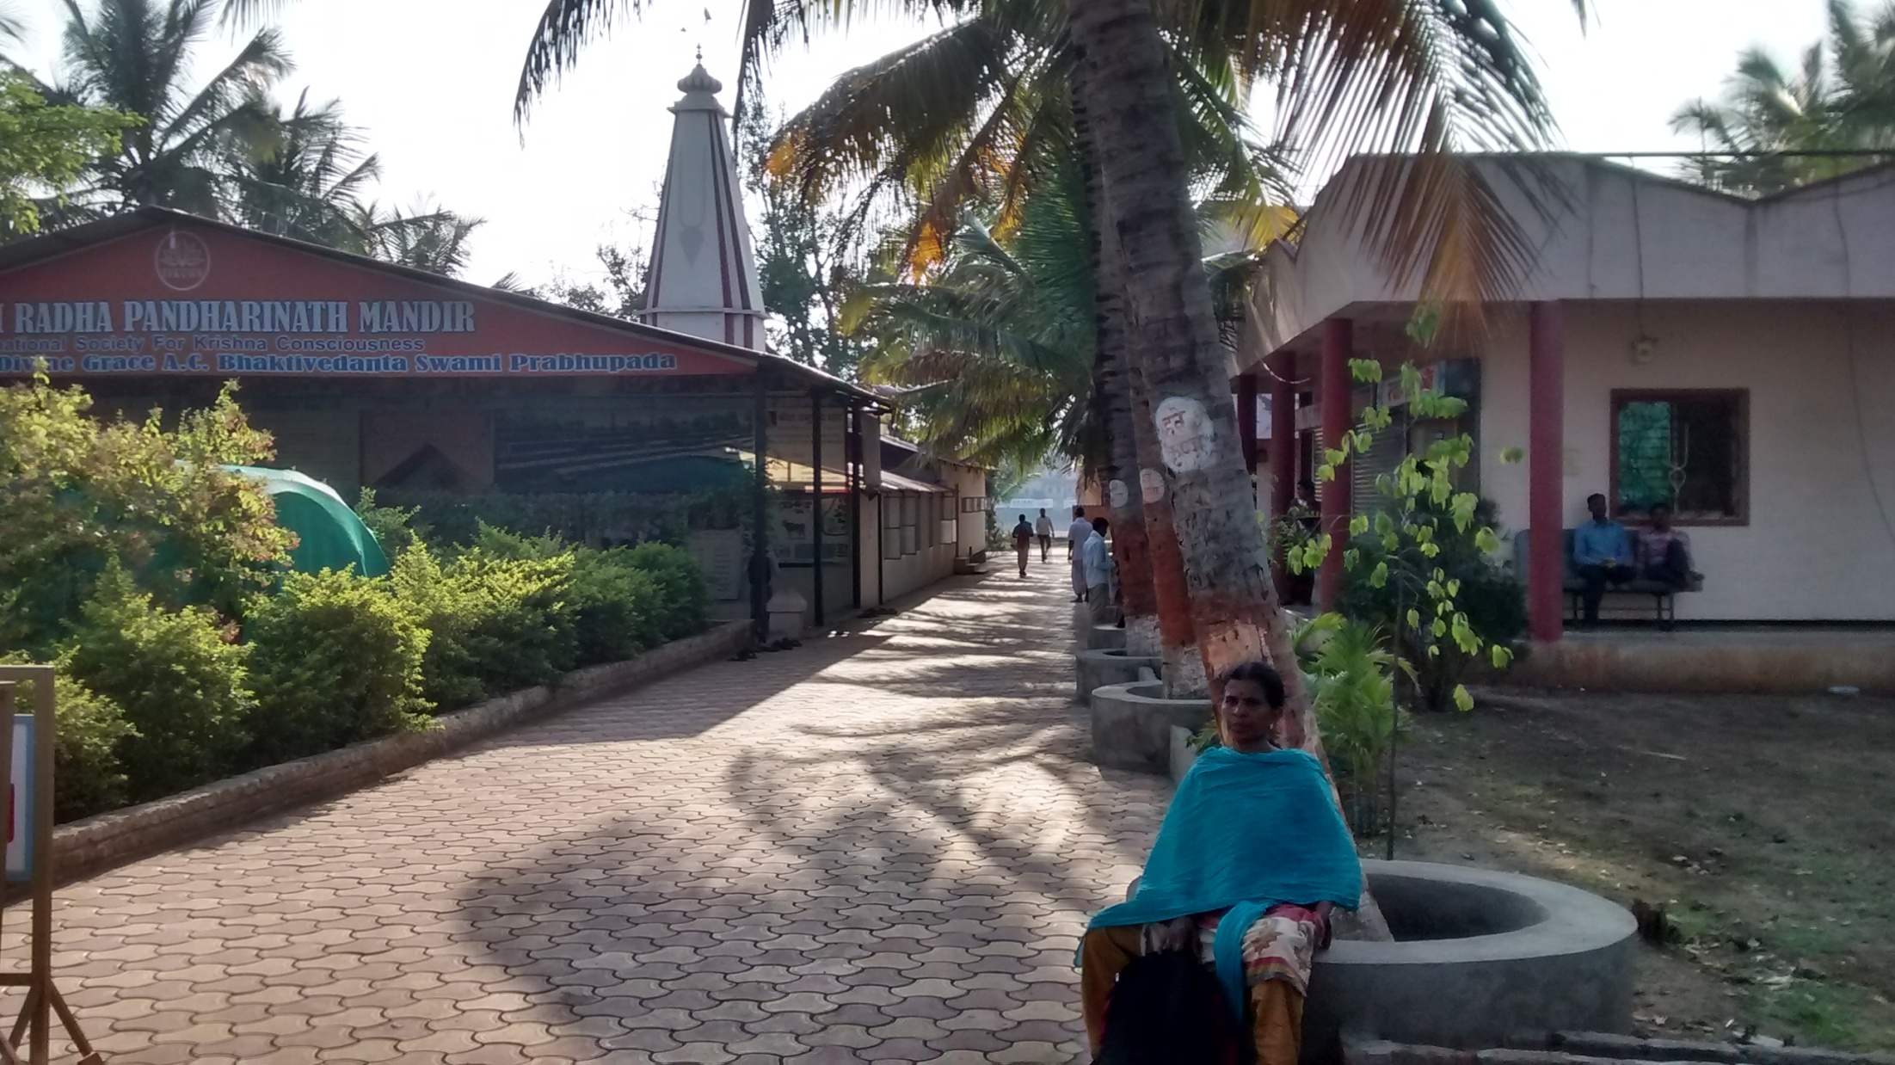
Notes:
We stayed in iskcon..
Near the Chandra bhaga river.

Slide 5
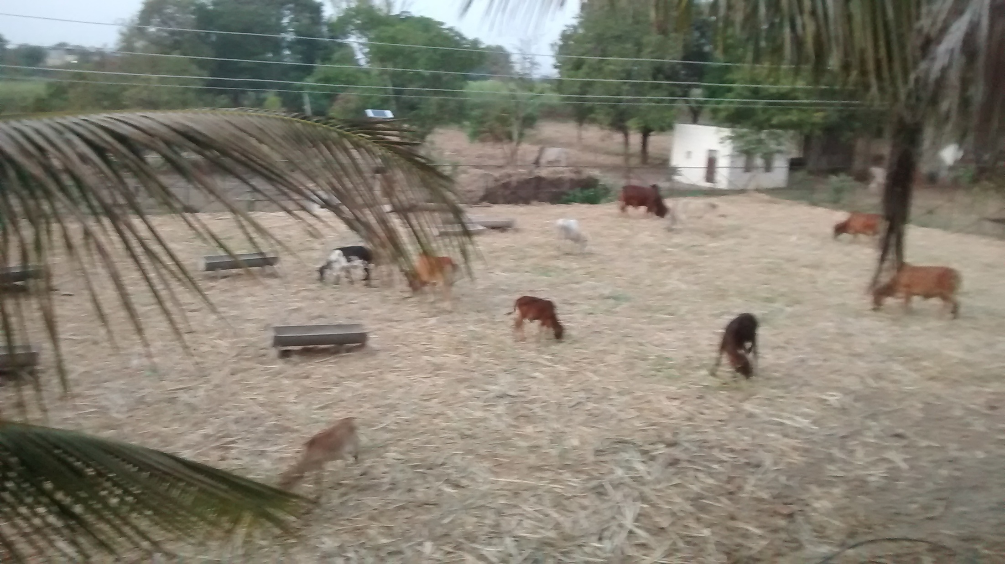
Notes:
Our nice room was facing the Go-Shala.

Slide 6
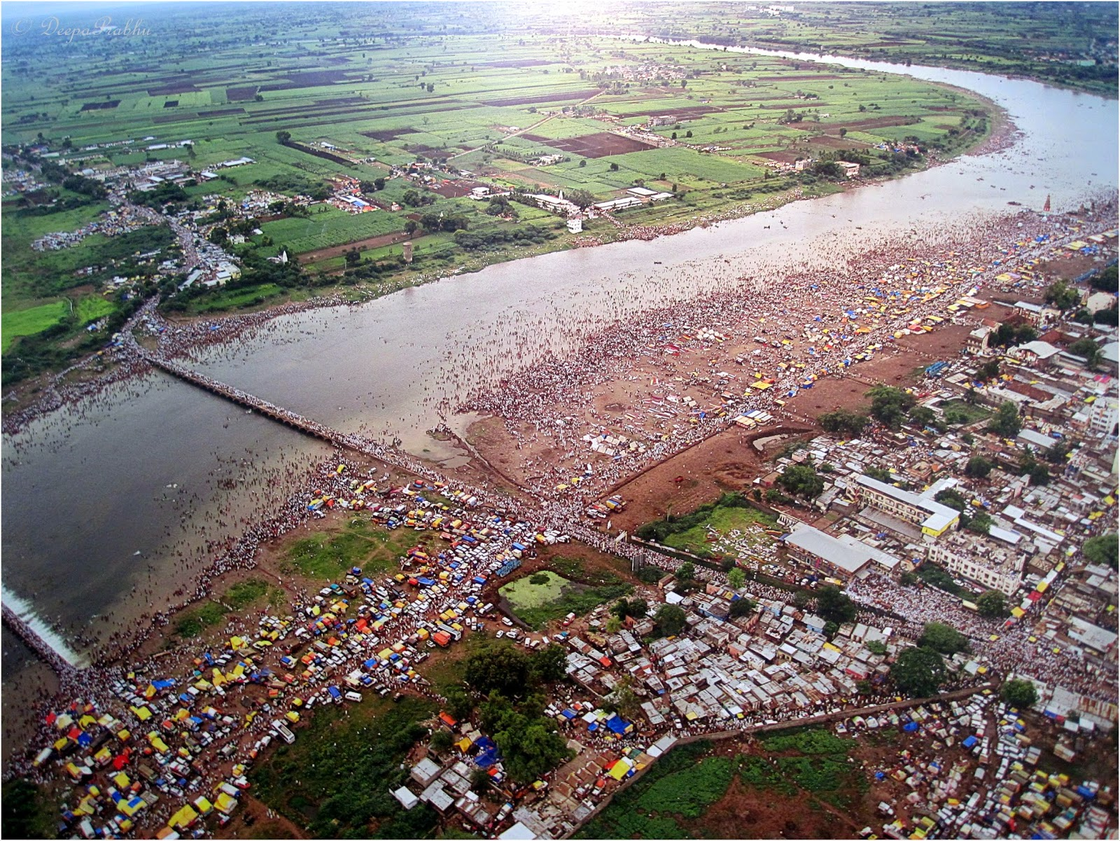
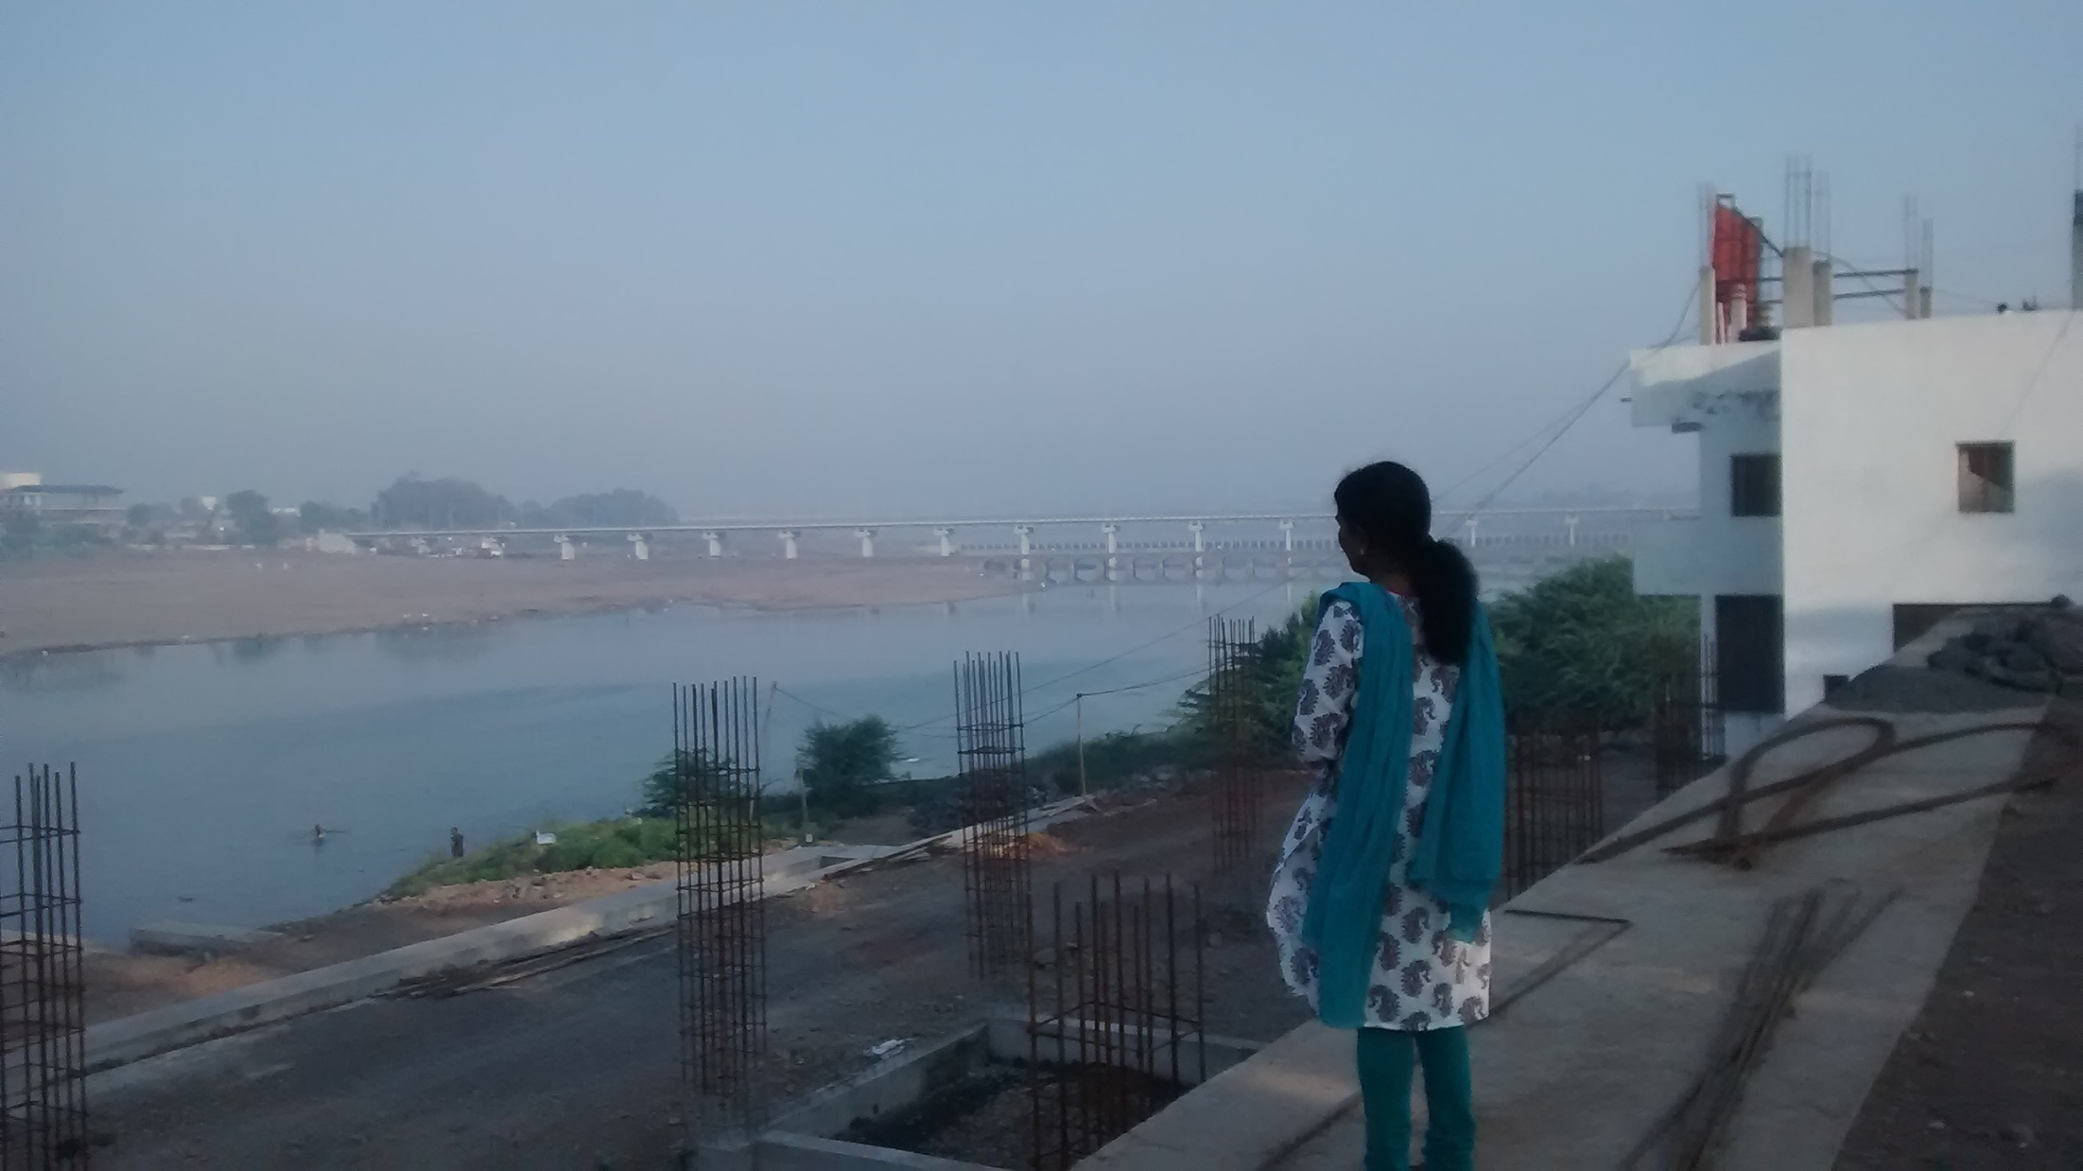
Chandrabhaga River, Pandarpur
Notes:
Chandrabhaga River:
Skhanda puran narrates this story of lord shiva’s fight with Tripurasur. Once Tripurasur was causing havoc in all three worlds. Lord shiva fought valiantly and killed Tripurasur. While killing him Lord shiva perspired heavily. His perspiration took the form of a river and traversed the earth planet causing flood. When this flood reached pandharpur the residents became fearful and prayed to Bhairav who is the guardian of this holly place. Lord became angry on river and was about to destroy it. The river in turn prayed to Lord Vitthal for protection. Lord Vitthal assured her protection and allowed her to flow through pandharpur, but withot making any noise. This river is non another than river Bhima and because she half circumambulates pandharpur like half moon, hence here she is also known as chandrabhaga.

Slide 7
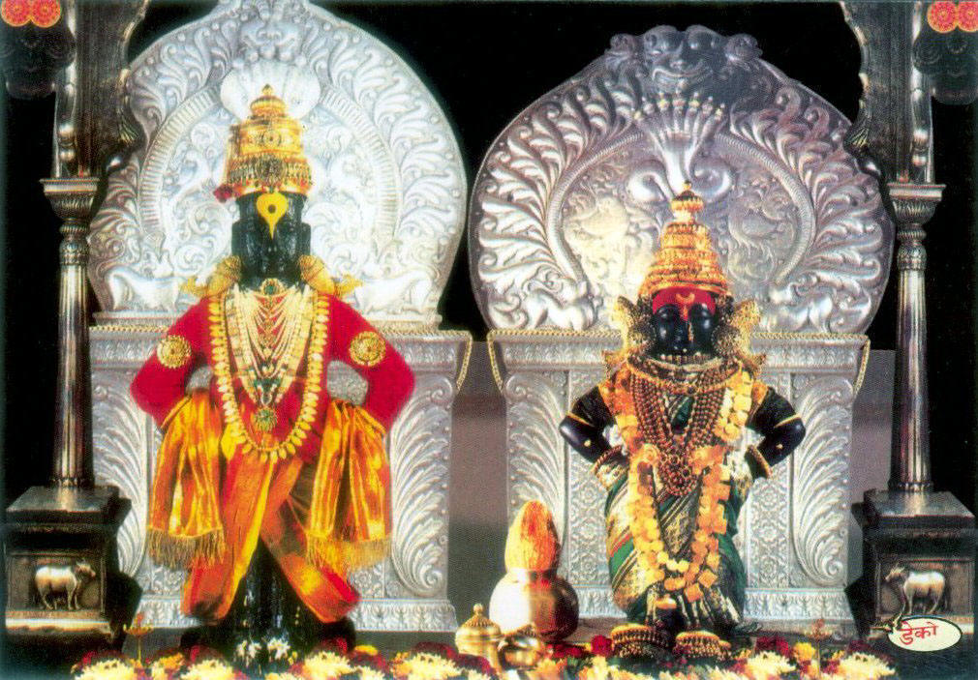
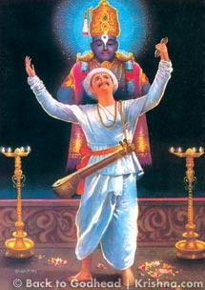
Notes:
There lived many great saints..
One of them was Saint Tukkaram.

Slide 8
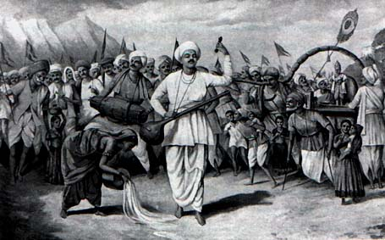
Notes:
Words are the only jewels I possess Words are the only clothes I wear Words are the only food that sustains my life Words are the only wealth I distribute among people Says Tuka, witness the Word, He is God I worship Him with my words - Sri Tukarama
What are those words?

Slide 9
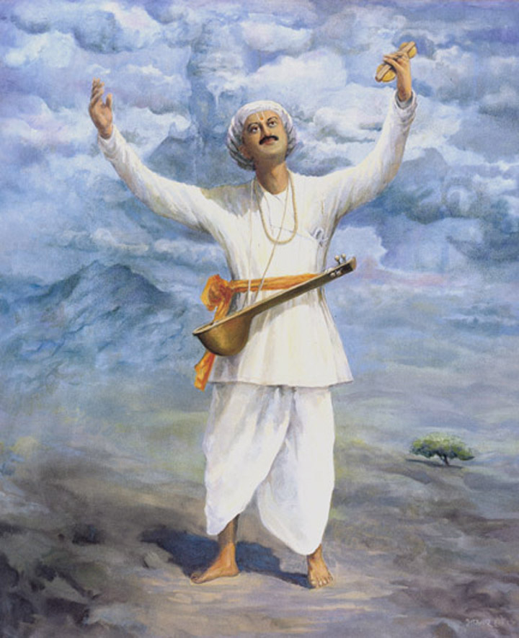
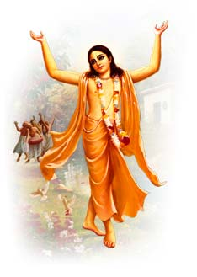
Notes:
Tukkaram has written and also said,
“I was initiated by a sanyasi called Caitanya. When I got initiation, I was dead. He gave me the mantra thyat has Rama, Krishna and Hare”
Who is this?
Later when Lord Caitanya came He went to visit this place to honor His devotee.

Slide 10
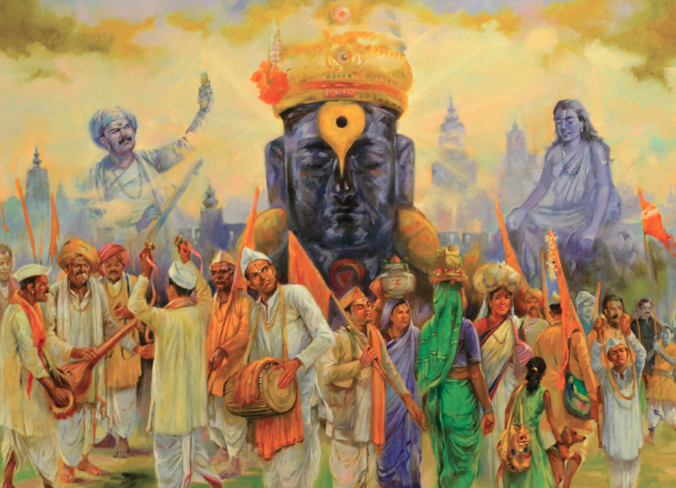
Notes:
As per the instructions from Caitanya, Tukkaram distributed the namas of the Lord..
People gathered and sang the glories of the Lord.

Slide 11
Aacharyam etad dhi manusya loke
Sudhaam parityajya visham pibanti
Naamaani naaraayana gocaraani
Tyaktvaanya vaacah kuhakaah pathanti
--- Mukunda-Maalaa Stotra - 38
[ The greatest wonder in human society is that people are so ignorant that they reject the life giving nectar of Lord Narayana's names and instead drink poison by speaking everything else. ]
OV-27

Slide 12
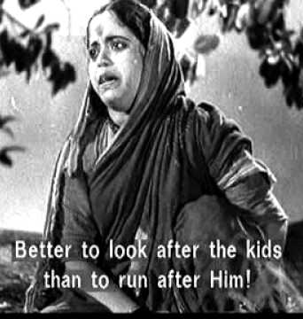
Notes:
Even Tukkaram’s own wife did not realize it!
Tukkarams early life was not that bad.
But he did not attend the school..
Instead, he was going to Vital temple and used to weep!
Father was a poor farmer. Did not enforce studying..
Later he got married to a girl. But she and children died due to poverty.
Then he married another girl called jija bai.. She was very different..
Dukkaram was fully immersed in devotion. Went to all places and gave hari-kathas.
But his wife publicly scolded her husband and advice not to do devotion but take care of the family.
Once he gets a job in sugar cane. Brings some but distributes to every one else.
Jija Bai beat Tukkaram with the sugar cane left, breaking it into 2..
Tukkaram wrote so many abhangs – poems on Vital and Rukmini
His Tanpura was given by Narada Muni.

Slide 13
Notes:
Now those treasures of prayers and hymns for Lord Vital and Rukmini are sung so nicely.

Slide 14
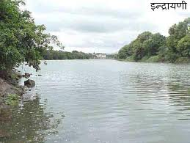
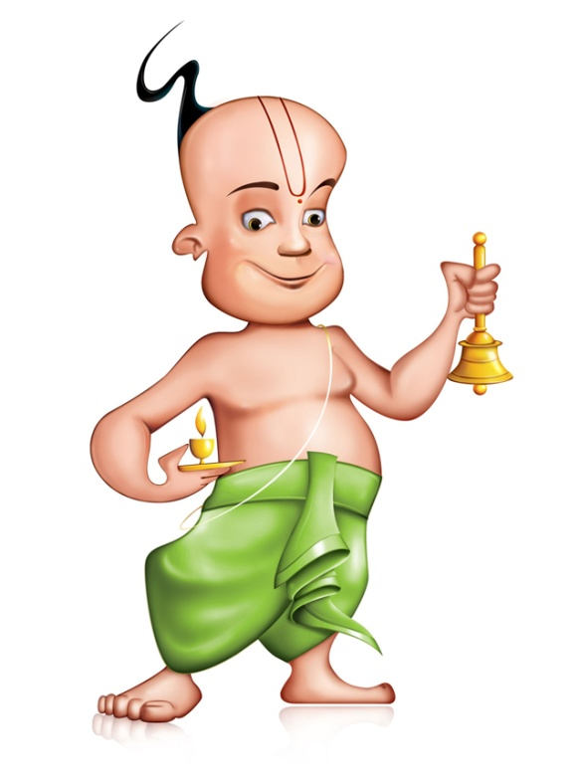
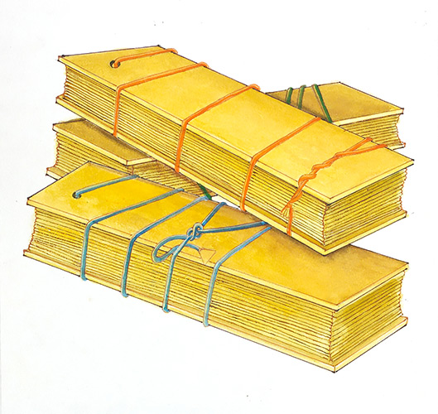
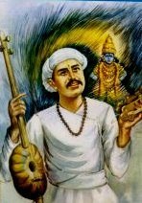
Notes:
There was a pundit who became jealous.
He put the order that all the poems of Tukkaram should be thrown into the Indrani river.
He did with tying a big stone..
Later after several days all the scriptures came out .
This was already given to the temple pujari and others in the dream.
The people placed Tukkaram on a palanquin and celebrated.
These are sung in the temples..

Slide 15
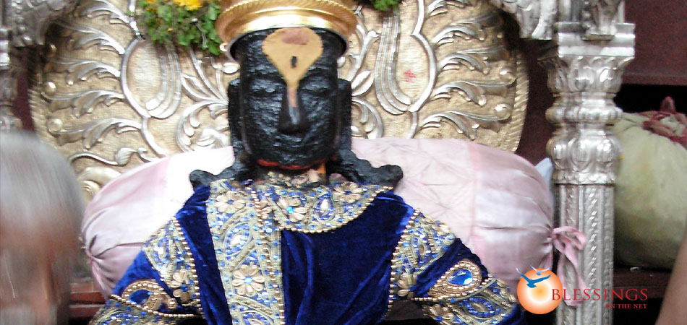
Notes:
What is sacred thing about this place?
Story of Pundalikka and this place..
Let us go back 5000 years back..
Pundalikka treated his parents very badly. They went to kasi.
But he took his newly wed wife also to there and gave more trouble.
Once he was staying in the ashram of kukkuda muni, and in his vision many divine ladies entered inside and wiped the fllor with their hairs, then they left.
“We are the holy rivers.. By wiping this place, we become pure...
But you have done too many sines and hell is waiting for you..”
He changed and was taking care of their parents. He worshipped Krishna and became bhakta.
That time, due to Radha Rani’s one amsa coming to Dwaraka, Rukmini got upset and ran out of Dwaraka.
Krishna was searching for her and found here at this place.
She was standing in the mood so that her arms were like now.
Krishna after finding her, consoling her, they wanted to see his bhakta.
Krishna came and called, but Pundalikka was in the middle of service.
So he threw a brick to Krishna to stand as it was hot outside.
“One more please. For Rukmini”
He threw one more brick, and they both were standing on the bricks until Pundalikka was free..
This same place is Pandalpur where the Vital temple is situated.

Slide 16
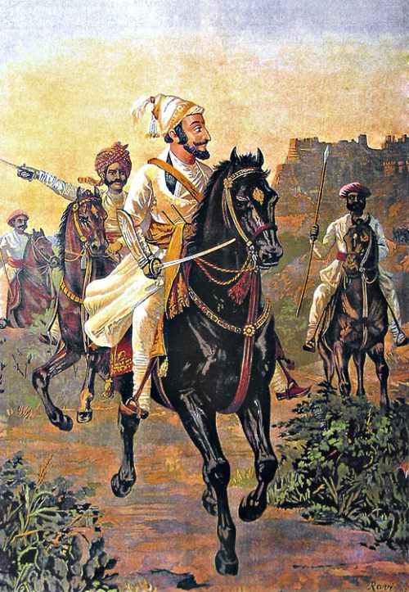
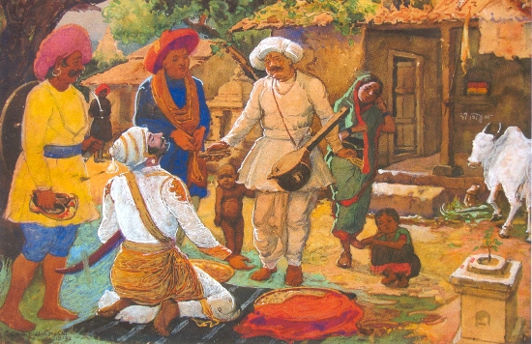
Notes:
Shivaji came to know the glory of Tukkaram.
Sent many gifts.
Tukkaram rejected even though his wife and children loved.
All gifts returned.
Shivaji then came by himself and bowed down to Tukkaram.
Took initiation from Tukkaram.

Slide 17
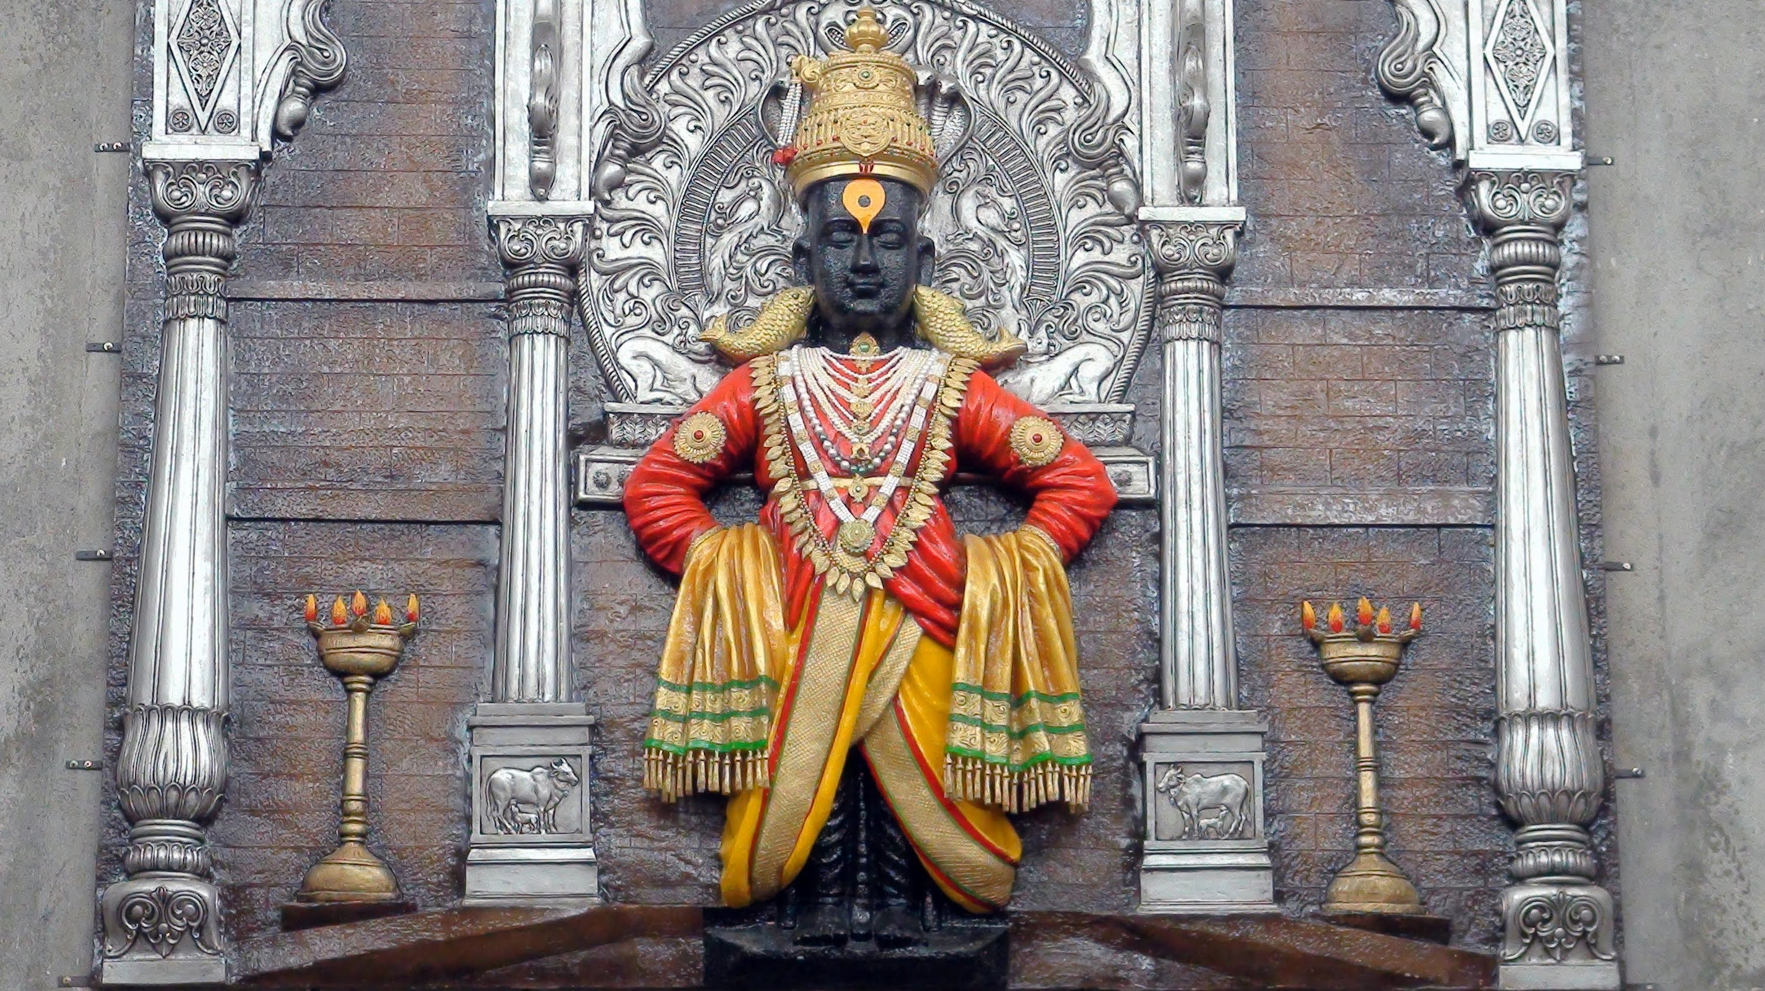
Notes:
Once Shivaji was inside the temple with Tukkaram.

Slide 18
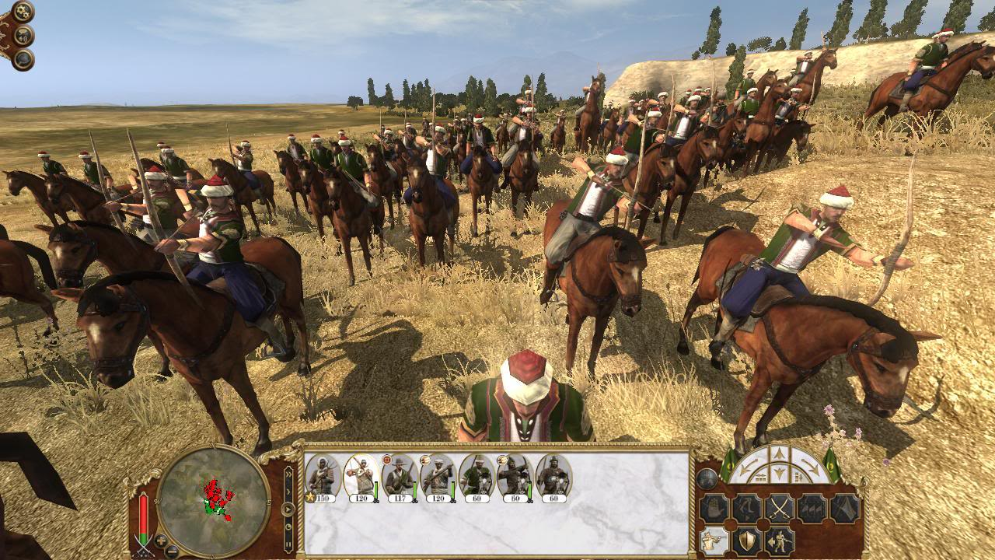
Notes:
Knowing this, Aurangazeb sent army to capture or kill Shivaji.
They all came and surrounded.
Tukkaram sang a song.

Slide 19
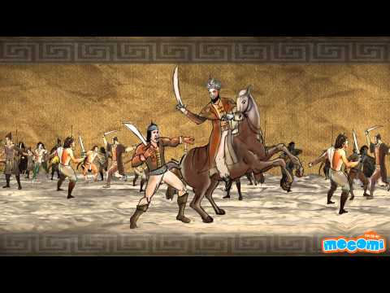
Notes:
Magically Aurangazeb’s own army killed each other and ran away.

Slide 20
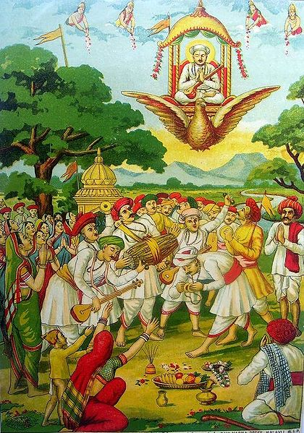
Notes:
The Period of Tukaram (1608–49)
One fine day he declared to every one that he wwill be taken to vaikuntha and begged others to join.
But even his own wife refused.
“My work here to take care of children and buffallows is more important than going to Vaikuntha”
Exactly as he said, the garuda Vahana came.
He let the Veena given by Narada was set to float back to vaikuntha..
Then, Tukkaram got in and went back.

Slide 21
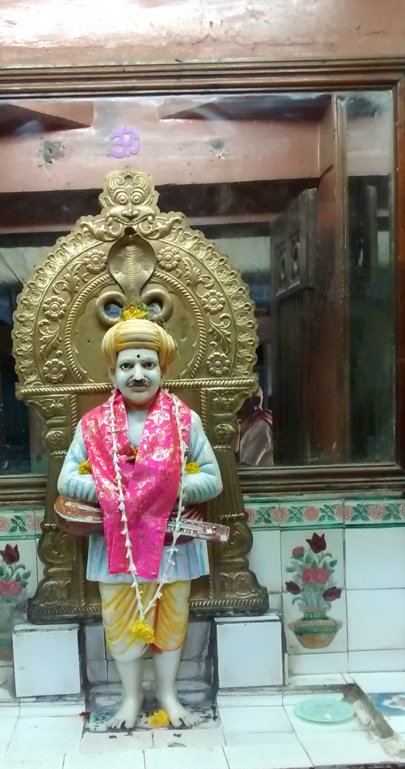
Notes:
The Period of Tukaram (1608–49)
This is the place of his old house.

Slide 22
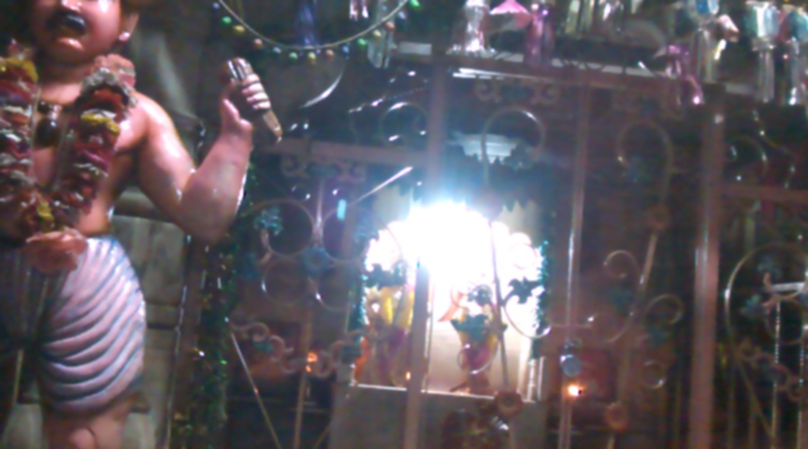

Slide 23
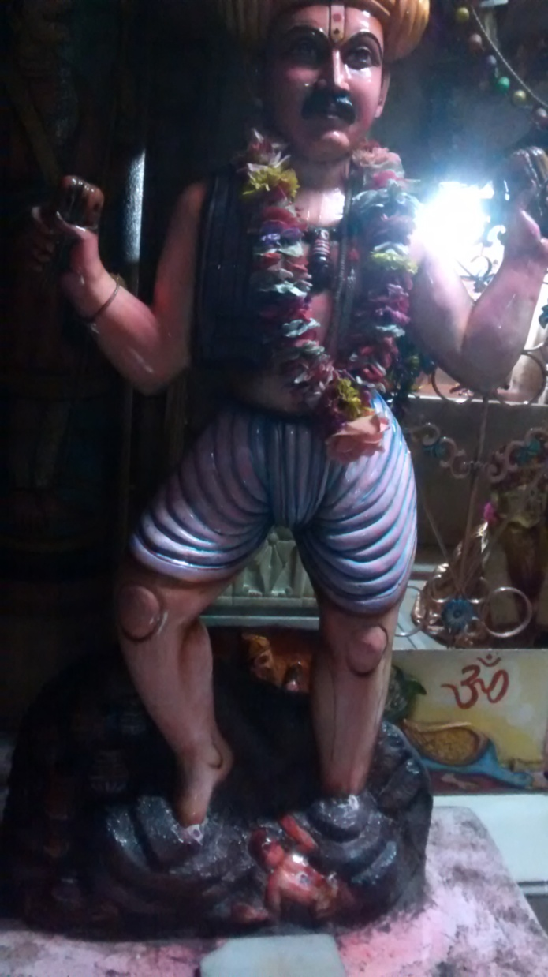
Notes:
You can listen and understand.

Slide 24
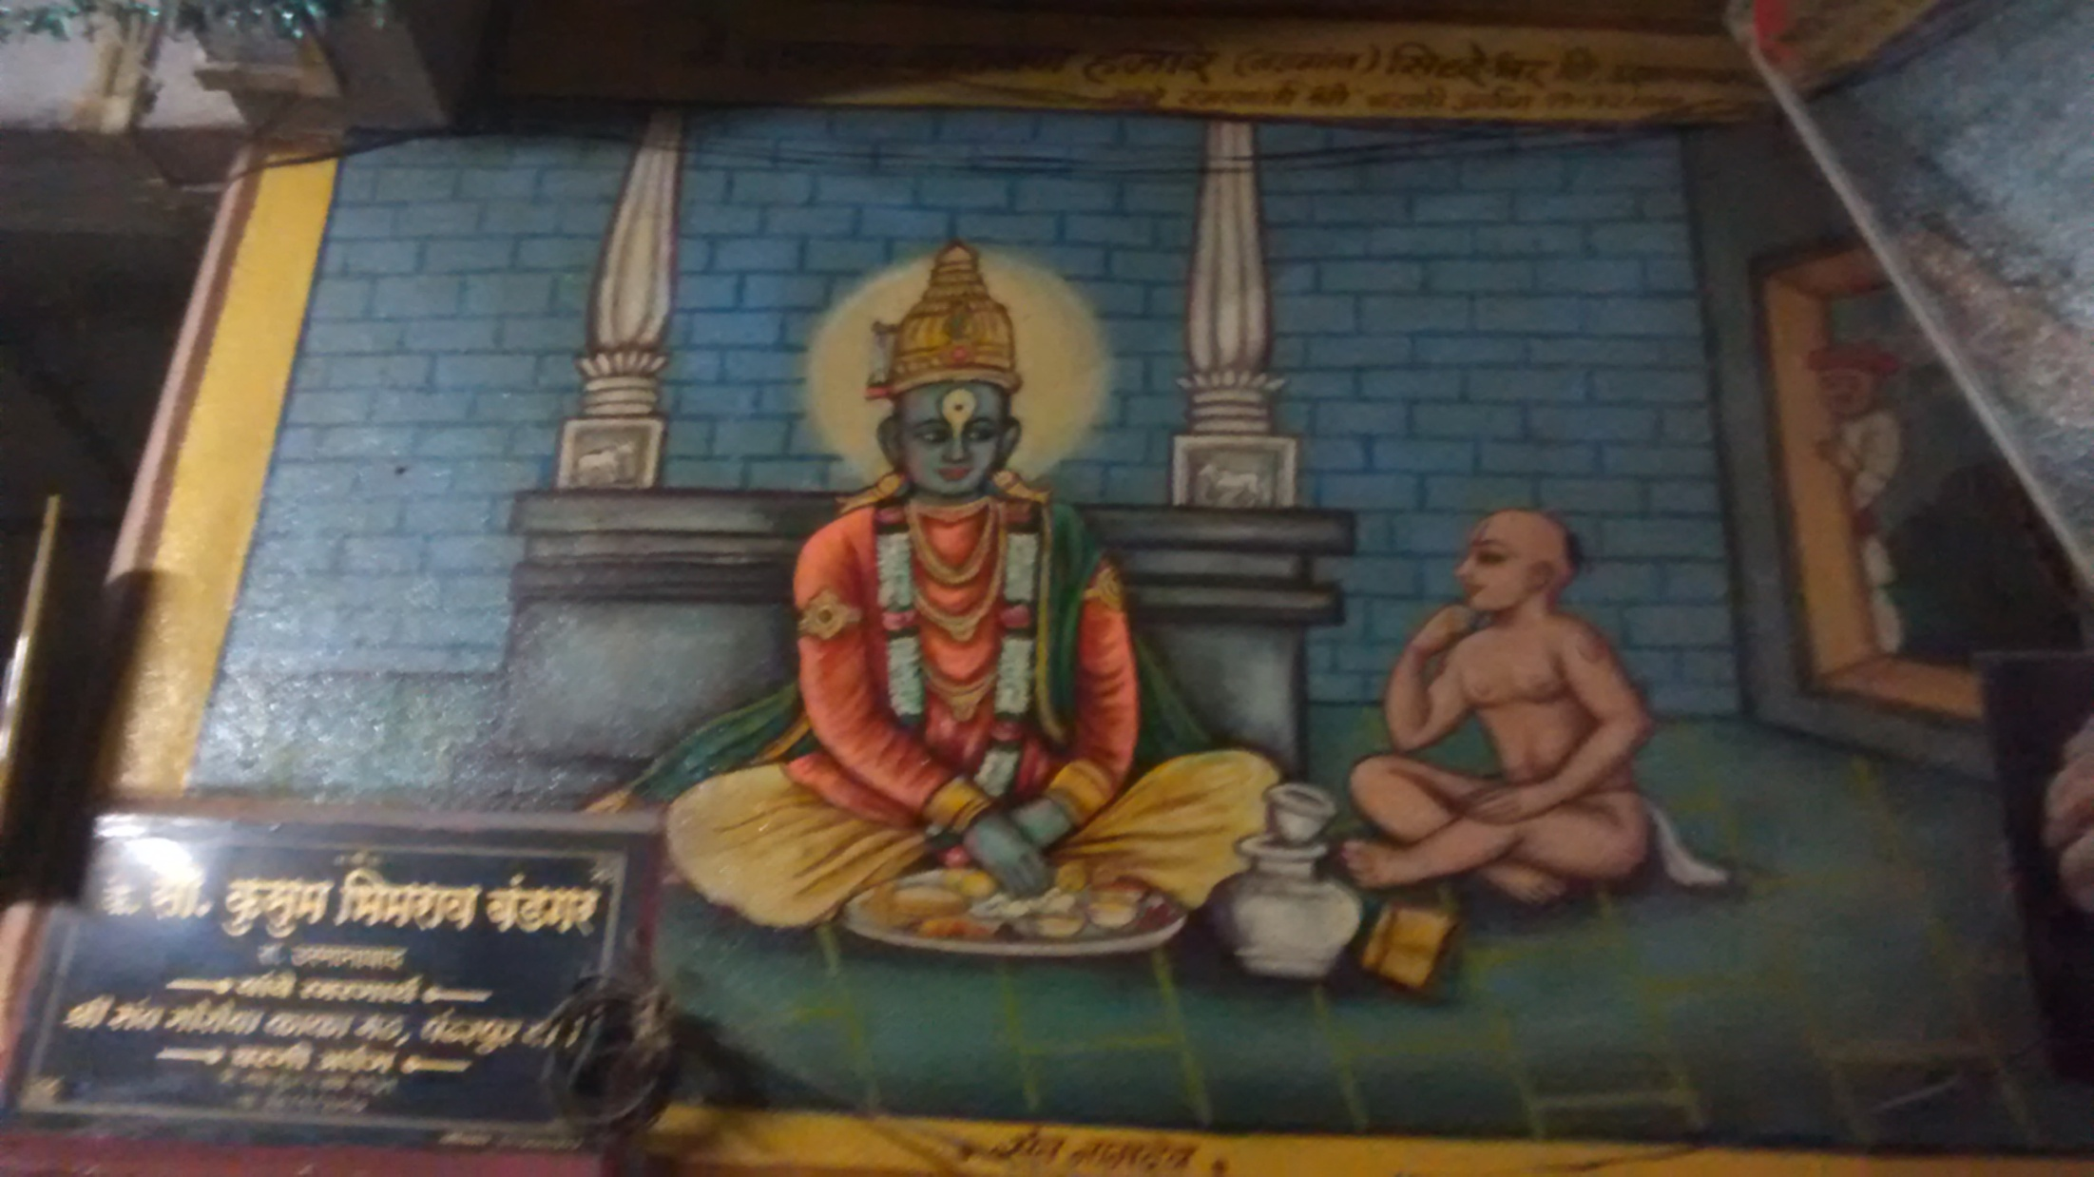
Notes:
There it seems that there was another case where the father of a child goes on pilgrimage.
Asking his child to do the feeding to the Lord Vital at home.
The child brings the plate..
‘eat”
...
..

Slide 25
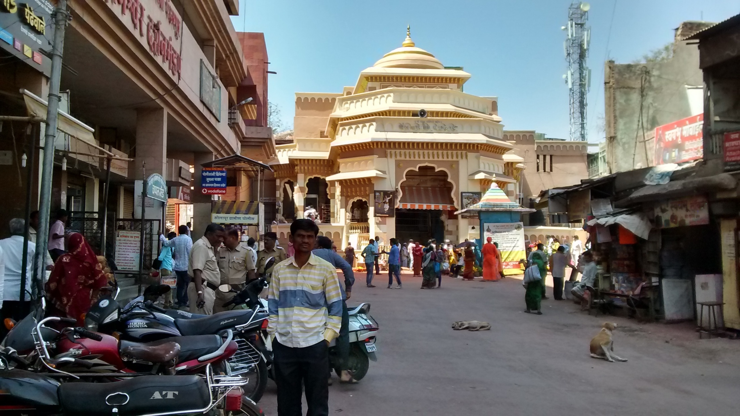
Notes:
The main entrance of Vital Temple.

Slide 26
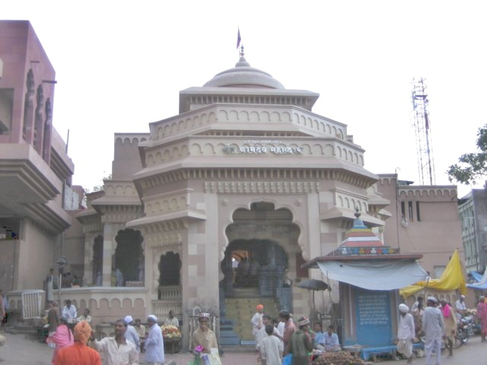
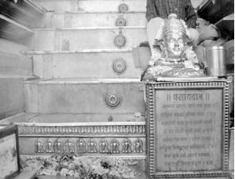
Notes:
This is the entrance to Vital temple (Vidhoba)
Namadev appeared before Saint Tukkaram.. He wanted the Lord to place him such that the dust from the devotees fall on him. Lord opened creacked the earth so that he and his family could walk in and enter. We can see this place still at the very beginning on the main entrance.
Namdev Payari (Namdev's Steps)
Saint Namdev prayed to lord Vitthal “ oh lord, I do not want Vaikuntha , but only aspire to get dust from feet of all devotees who visit you. I wish to become the steps on your doorway.” In answer to his prayers lord Vitthal arranged for the ground near the steps to part . Saint Namdev with his whole family entered into the ground. This step is even today visible on the main front door of Lord Vitthal’s temple and is called as NAMDEV PAYRI.

Slide 27
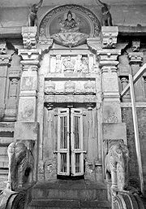
Taak Pithe Vithoba Temple
Story of Rama Bai
Notes:
Taak Pithe Vithoba Temple
This temple is close to west gate of the main vitthal temple. Long ago one old devoted lady of the name Ramabai used to stay here. She had come here from Paithan on the order of Lord himself. She would everyday serve Lord in the main temple and only eat food which is offered to Lord. On the order of Lord everyday she would bring a special food item “TAAK PITH”-Butter porridge and the Lord would relish it . As years went by Ramabai became old and could not come to temple. So lord himself along with Rukmini devi went and stayed in her house.
There lord like a child would demand and relish her TAKH PITH. When Ramabai’s health improved and she was able to go again, the lord decided to return. At this time she requested the Lord to stay permanently in her house. Agreeing with her Lord decided to expand and stay here also . even today during Ashadi Ekadashi when pilgrims can’t take darshan of the main deity they come here knowing well the non difference.

Slide 28
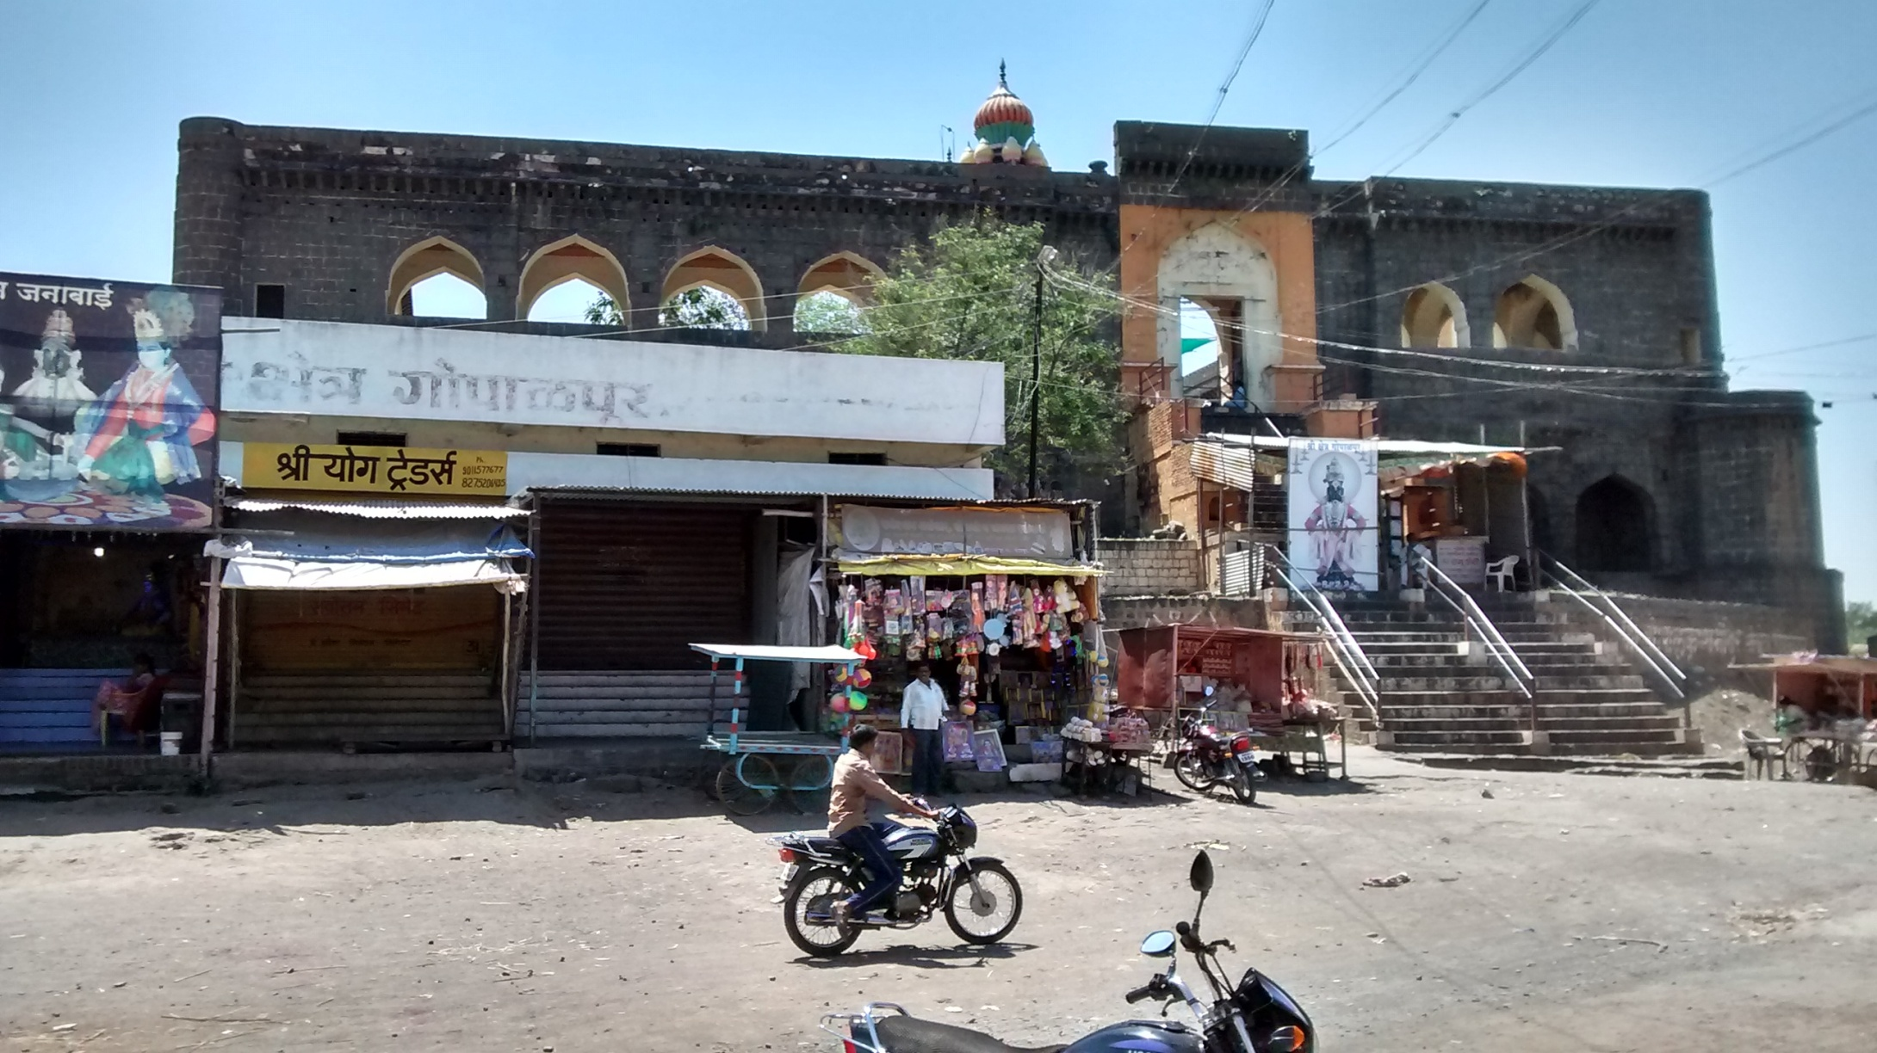
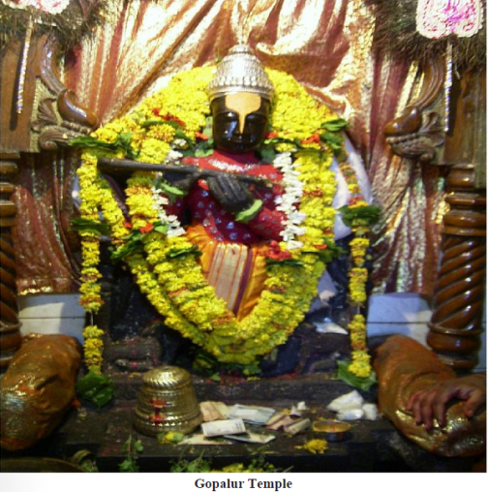
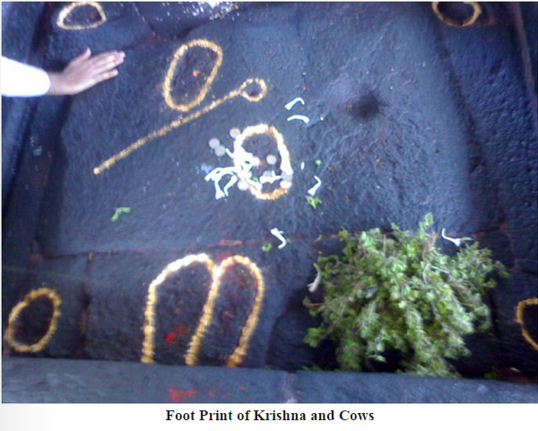
Notes:
Gopal Pura lies 2.5 km soth of pandharpur. Gopalpur temple is on a hill which is also called as Gopalpur hill and is non different from Govardhan hill.
Once lord Krishna with his cows came to visit Pandharpur.
This past time is commomerated even today at a temple called Vishnupad in Gopalpur, where Lord Krishna’s foot prints are embedded on a stone slab along with the hoof prints of cow and the prints of Krishna’s foot.
Local devotees say that this place is Lord Krishna’s eternal place of lunch pastime. Even today this pastime takes place. Narada muni’s small temple demonstrates his everyday’s visit to witness this. At gopalpur River Pushpavati meets Bhima. This Pushpavati river is nondifferent from Yamuna.
On the first day of the month of Margashirsha, Lord Vitthala’s sandals are taken to this vishnupad temple. On the last day of the same month, Lord Vitthala’s chariot is brought to the temple in a grand procession.

Slide 29
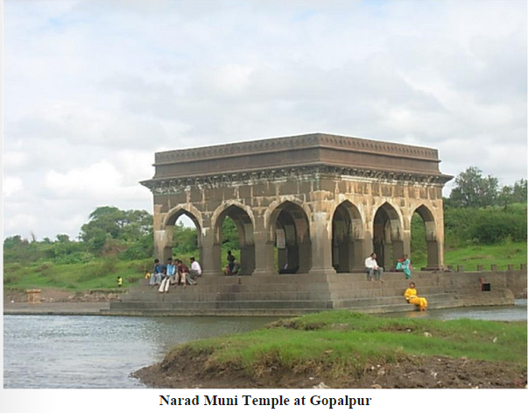
Notes:
Narada Muni is believed to be coming even now to witness the pastimes at this place.

Slide 30
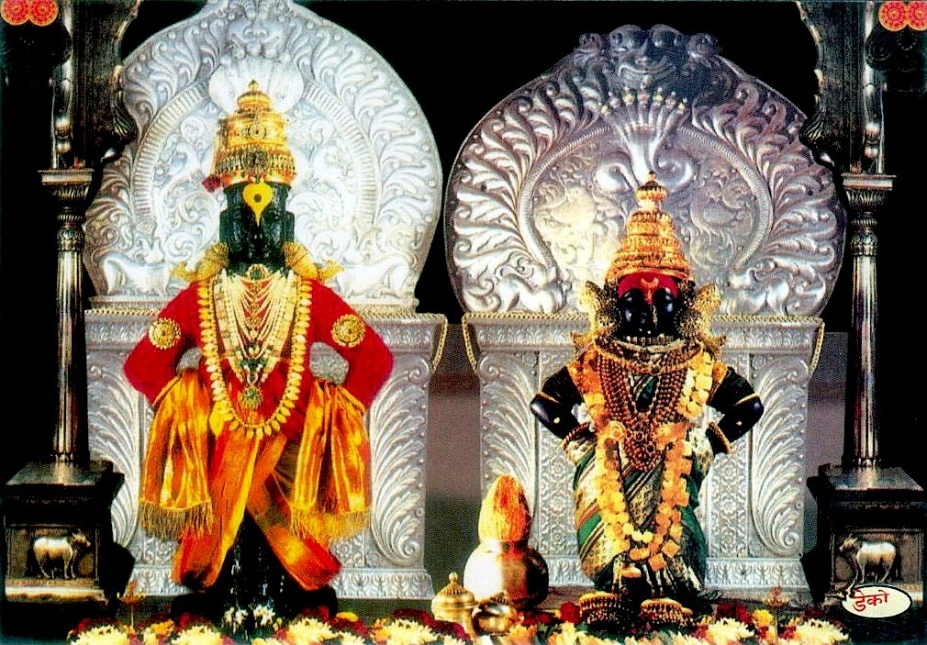
Story of Janabai
Notes:
Story of Janabai
One day in the month of Karthik (November) the Vitthal Rukmani temple in Pandhari was filled with Pilgrims. Janabai had come there with her parents as a pilgrimage to the temple. Sitting at the Mahadwar of the temple, she told her parents that she doesn’t want to go back with them and want to spend the rest of her life in Pandhari worshiping Vitthal. Jani was only 7 years then and the other pilgrims there were astonished hearing what she had to say. Her parents were greatly troubled hearing this. After several attempts to convince Jani, her parents finally left for their home, comforting themselves by thinking about her determination and love towards Vitthal.
Nama happened to see this little girl and asked her why she was alone and enquired about her parents. Jani said that Vitthal is her father and mother and that she has no one other than him. Hearing this, a feeling of compassion aroused in Nama for Jani and he took her home. Nama told Gonai that he found this girl in the temple and that she had lost her parents and we need to take care of her. From then on she would do all the house hold work in Nama’s house and would call her self the maid of Nama. She used to keep chanting the name of Vitthal whenever she did any house hold work and at night she used to sing about Vitthal and meditate upon him.

Slide 31
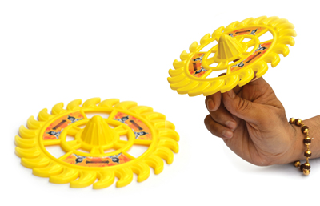
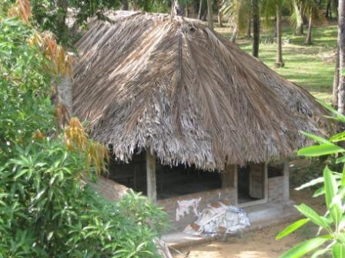
Notes:
One night when Nama was asleep, a fierce wind blew and that carried away the roof of Nama’s hut. Vitthal on seeing this sent his Sudarshana chakra to revolve around his hut so that Nama and his family could sleep. There were heavy rains but not even a drop of water went in to the hut. Vitthal then rebuilt Nama’s hut. When Nama woke up he saw Vitthal’s Pithambaram (Robe) shining outside his hut and he came out and fell in his feet. Nama then asked Vitthal what he was doing so late in the night here. Vitthal then told him that there was a storm and that his roof flew away because of it and he had come here to rebuild it. Vitthal then told Nama that if he had not come in time, his children would have felt the cold and Gonai would have become very angry with Vitthal and spoken to him harshly.

Slide 32
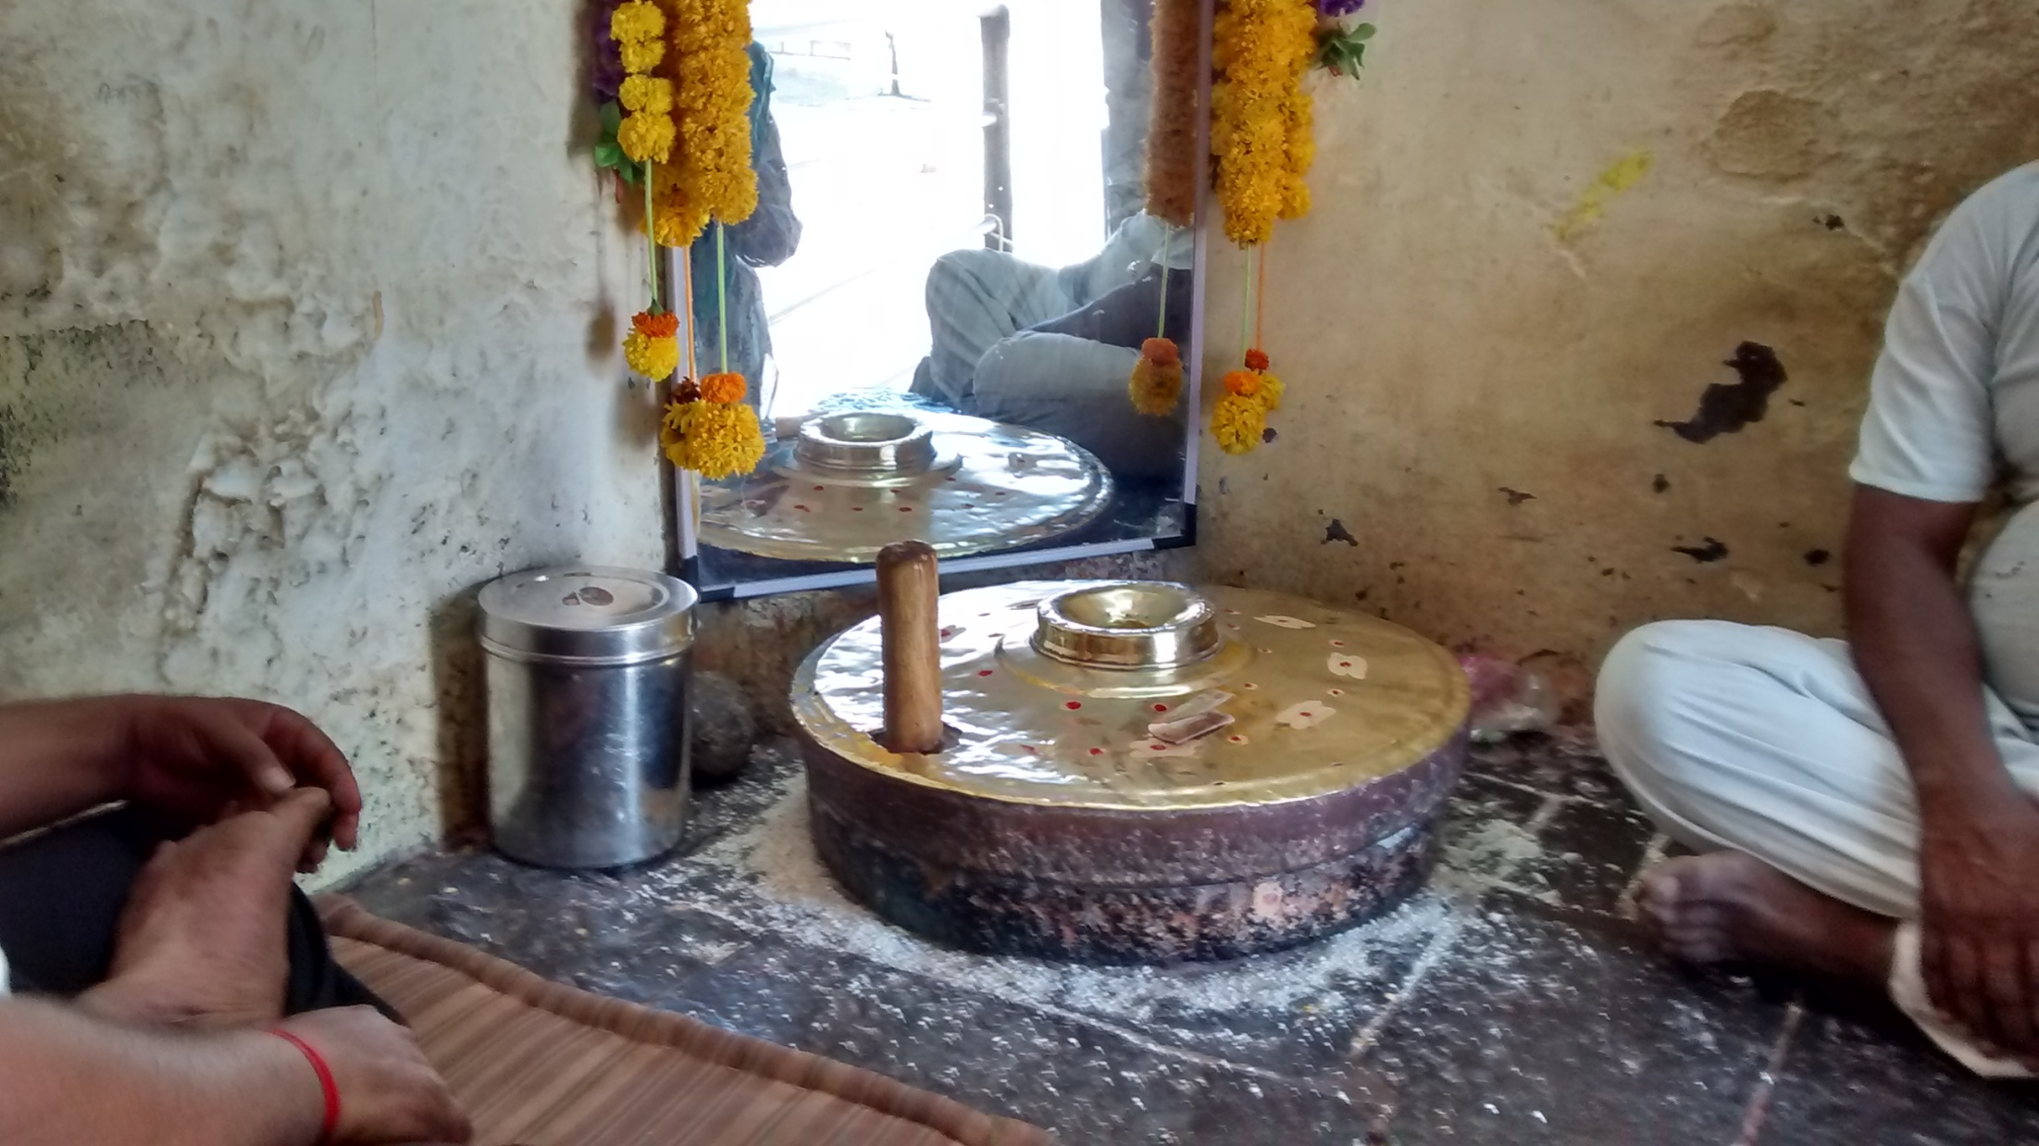
Notes:
Jana bai used to make nice abhangs for Vital and sing while she was grinding...
Once she was late to get up and Vitthal then came to Jani and told her to arise as it was time for her to grind the grains.
He also told her that he had cleaned the mill and is waiting for her. He then asked her to place her hands on the mill and asked her to sing her abhangs. Vitthal then did the grinding by himself and filled the basket with the flour.
(This mill is still there in Pandarpur and one can touch and see this when we visit Gopalpur temple – seeing above!!!)

Slide 33
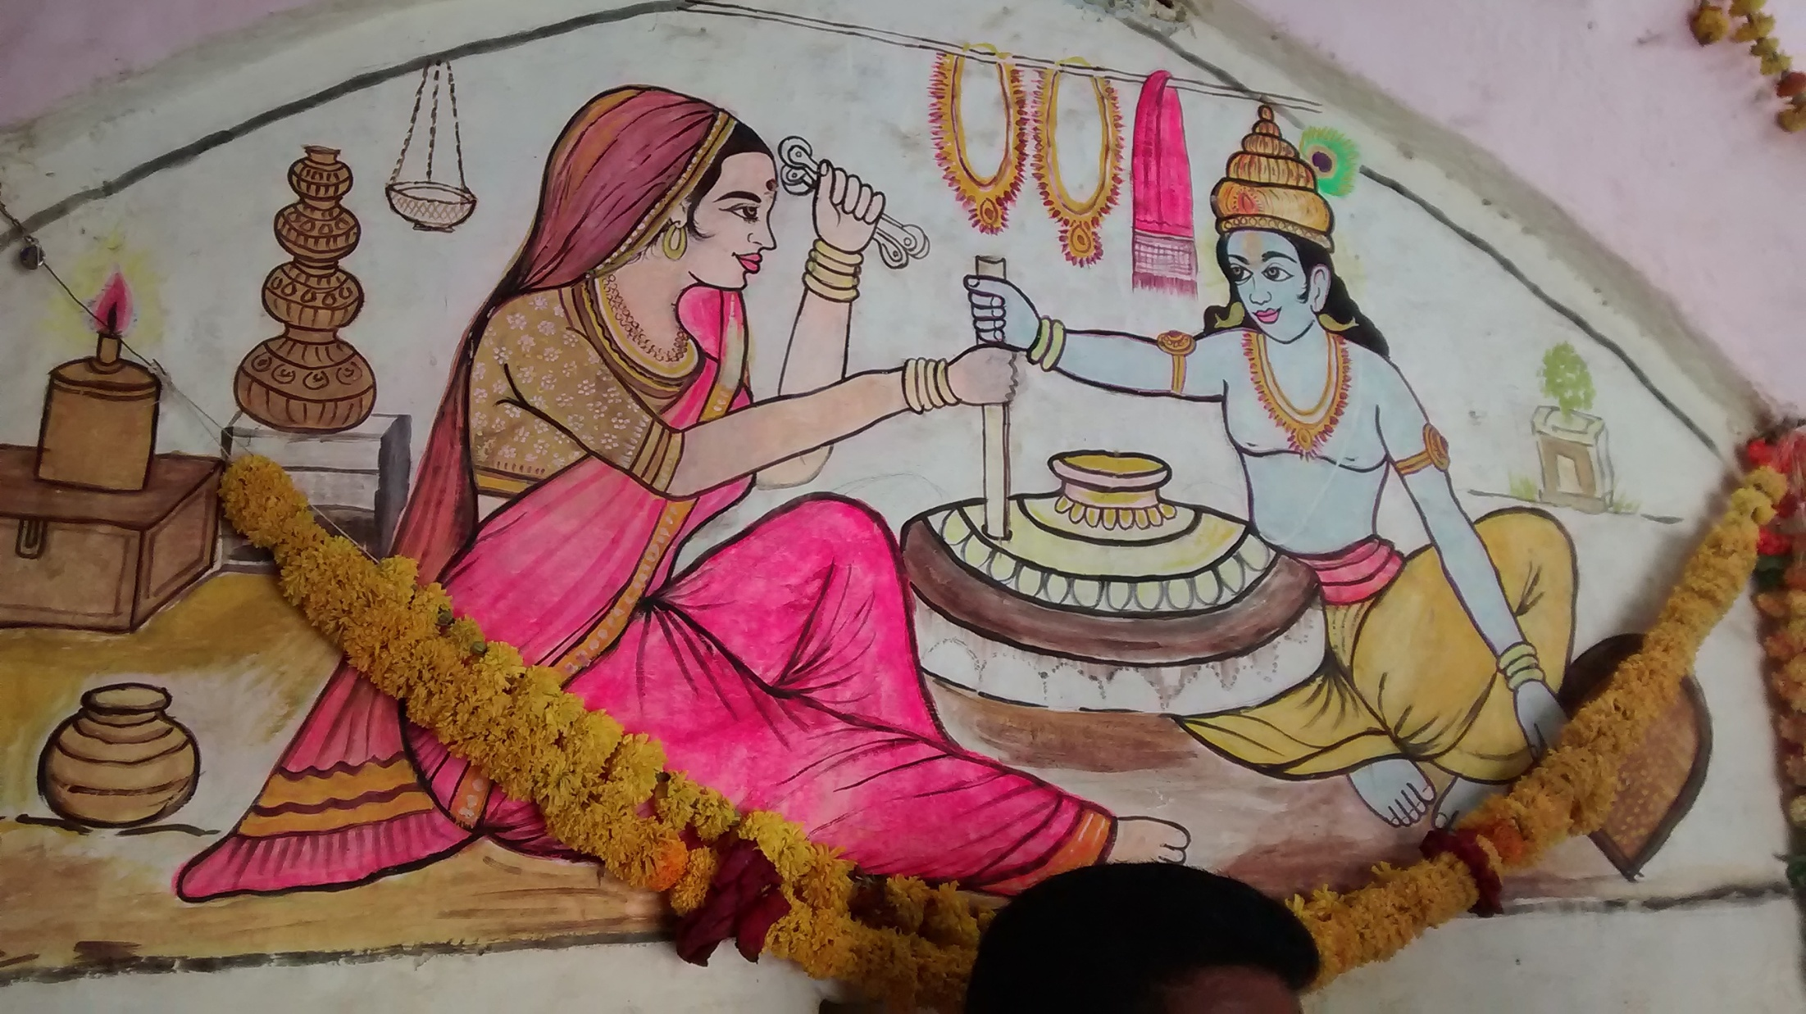
Notes:
Janai bai used to sing and Vital used to listen and grind the wheen 9atta / chicku?) for her.
Both used to hold together and sing..

Slide 34
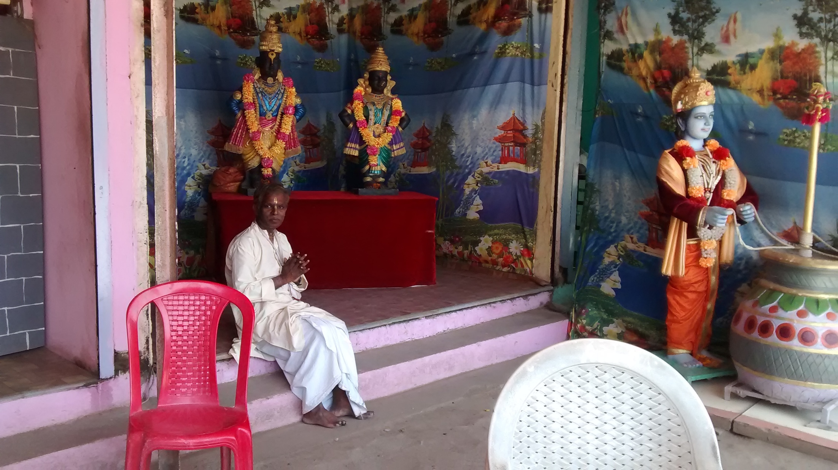
Notes:
Even now to remember this incident, around the temples also we see more grinding wheels..

Slide 35
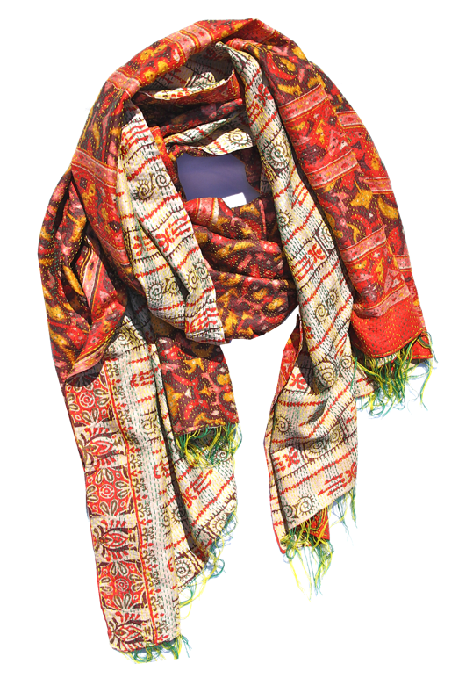
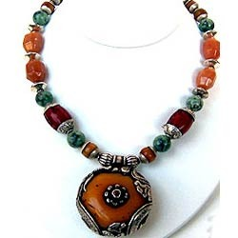
Notes:
Vitthal also used to sleep in Jani’s hut.
Once when the dawn began to appear Jani woke up Vitthal and told him that people would be coming to the temple and he has to go there immediately.
Vitthal left his necklace and shawl in Jani’s house and went to the temple with Jani’s shawl.

Slide 36
Notes:
When the priest opened the door of temple, he was surprised to see a different shawl on Vitthal.
One of the devotee’s said that the shawl belonged to Jani and when they removed the shawl they also found the necklace missing.
A group of people then came to Jani’s house and accused her of stealing the necklace and shawl of Vitthal.
Jani said that she had not taken any of these.
When they searched her house, they found the necklace and the shawl.
They then brought her to Chandrabhaga to impale her.
They tied her to an Iron rod and she was crying to Vitthal helplessly.

Slide 37
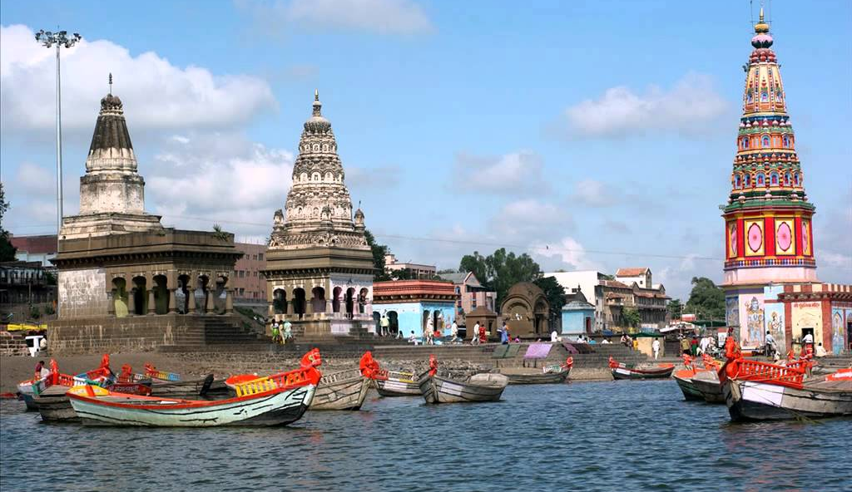
Notes:
The iron rod suddenly turned in to water and all the people who had gathered were astonished.
All of them then praised the Jani and prayed and sang about Vitthal.
There are also other temples in Pandalpur..
Need more days to live and explore for more..

Slide 38
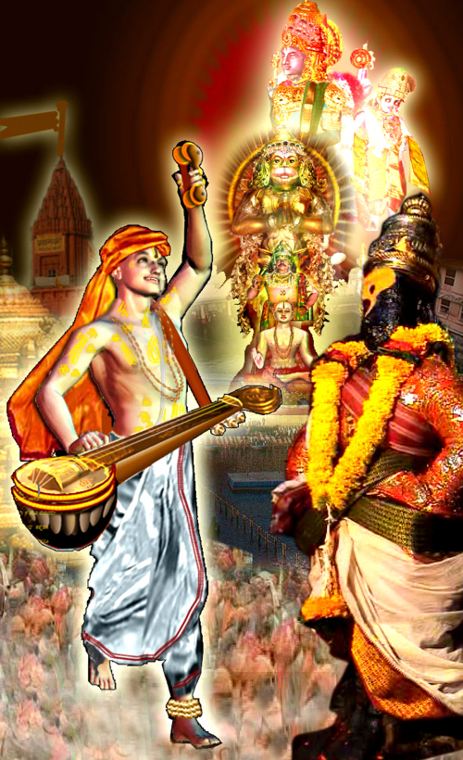
Purandara dasa
Form of Narada Muni
Composed 1 lakh kirtans
Considered father of Carnatic

Slide 39
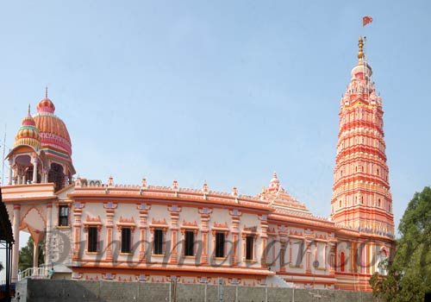
Notes:
Kumbakonam Tamil Nadu, temple for Vital.

Slide 40
Notes:
They conduct very big programs.

Slide 41
Notes:
Like Gaudiyas incline more towards Smt Radha Rani, many in the Tukkaram’s lineage also incline to Smt Rukmini Devi.
They call her Rukmayi, or Rengamma..
Here is a famous song sung by Sri Vital das.
I have personnally attended his programs and also received a special Tulasi Mala.

Slide 42
THANK YOU!
Hare Krishna!
Sri Vital Pandu Ranga Ki Jay!

